Slide 1
PaNOSC and ExPaNDS Communication and Dissemination
11th November, 2020
Authors: Isabelle Boscaro-Clarke, Nicoletta Carboni, Kat Roarty

Slide 2
PaNOSC – WP9 so far
Activities so far and ongoing:
Communication and Dissemination Plan updated: http://bit.ly/PaNOSC-CommsDissemPlan-update2020;
Continued development of the PaNOSC website;
Regular Social Media updates (Twitter: @Panosc_eu / Youtube: http://bit.ly/PaNOSC-on-Youtube );
Promotion of projects‘ results, activities & events via projects’ and partners’ websites, newsletters and social media accounts, lightsources.org and neutronsources.org mailing lists, LENS and LEAPS initiatives, CORDIS website, etc.;
Projects’ poster / video presentations at events for policy makers and the general public (e.g., ESOF 2020, EU for a smarter future conference);
Regular meetings with PMC / WP Leaders;
Promotion of PaNOSC presentations and publications, and monitoring of views (1978) and downloads (1454) of PaNOSC publications on Zenodo: https://zenodo.org/communities/panosc/;
Continuous interaction with comms staff at the partners to share PaNOSC updates with their communities;
Contribution to the collection of use cases

Slide 3
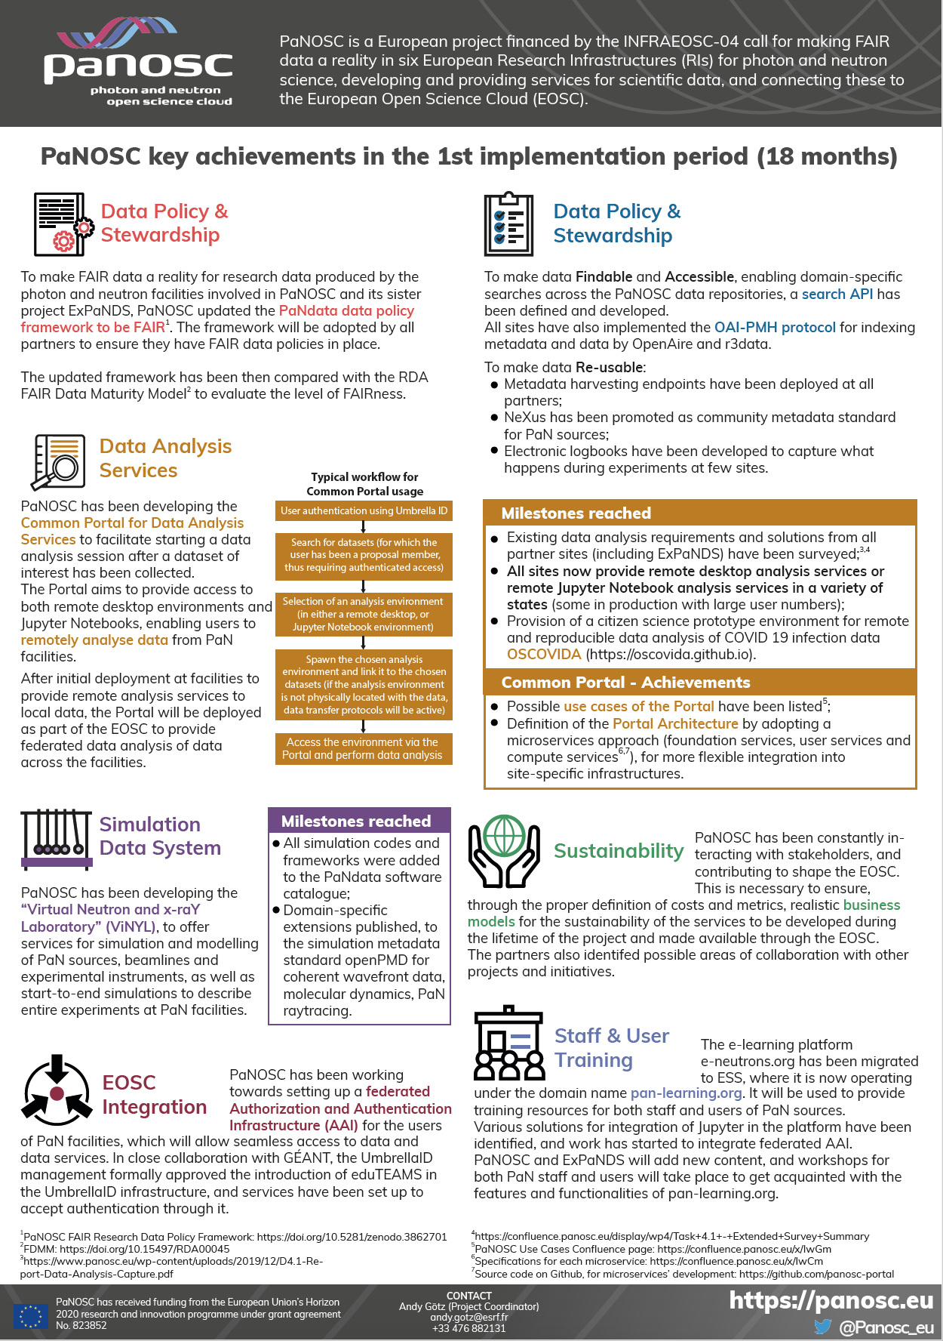

Overview of PaNOSC Progress & Key Achievements
PaNOSC brochure:
https://doi.org/10.5281/zenodo.4247623

Slide 4
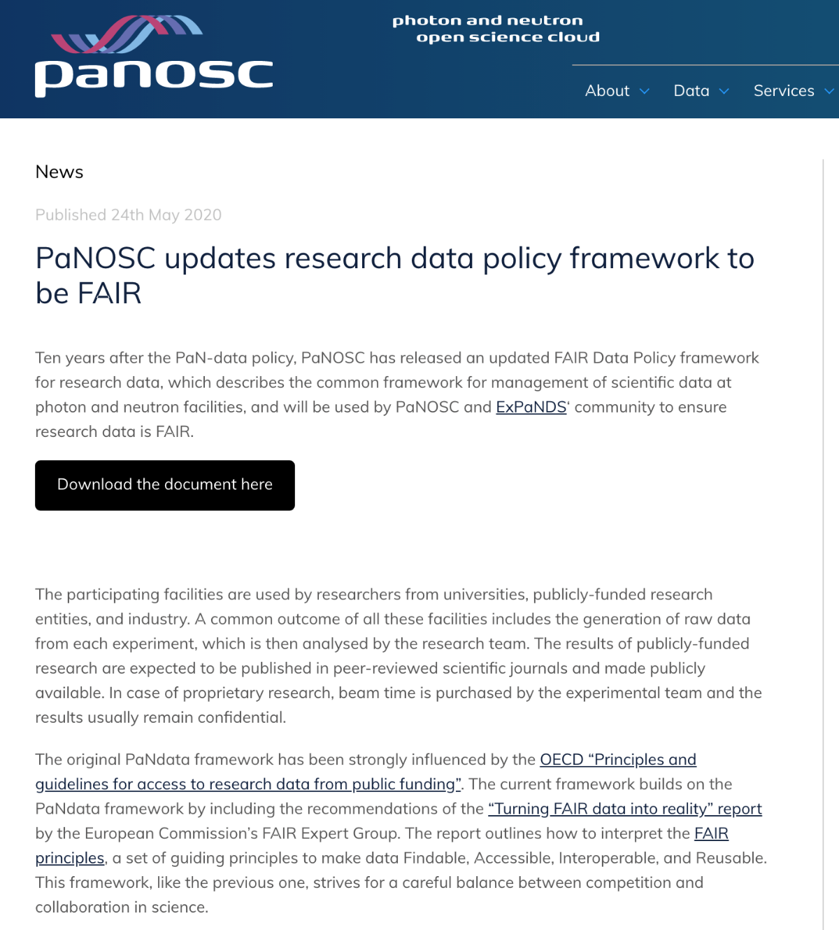
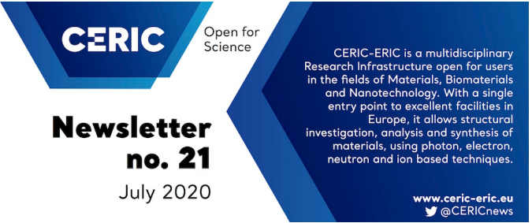

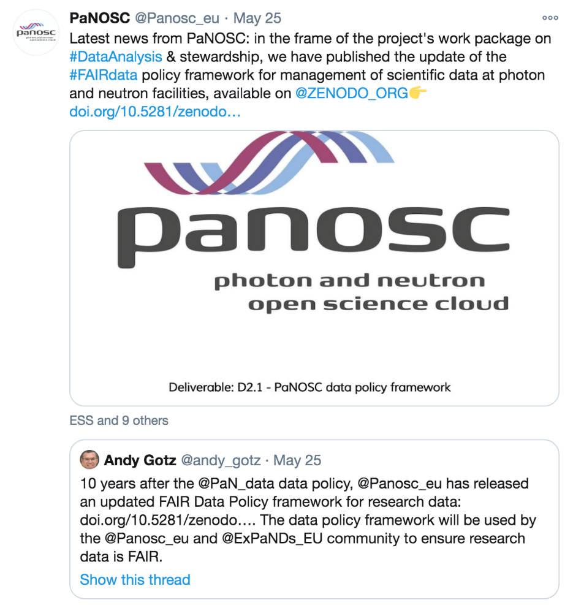


Dissemination of PaNOSC deliverables
News & social media posts, partners newsletters, etc. (example on release of
PaNOSC data policy framework)
Partners’ newsletter
CORDIS

Slide 5
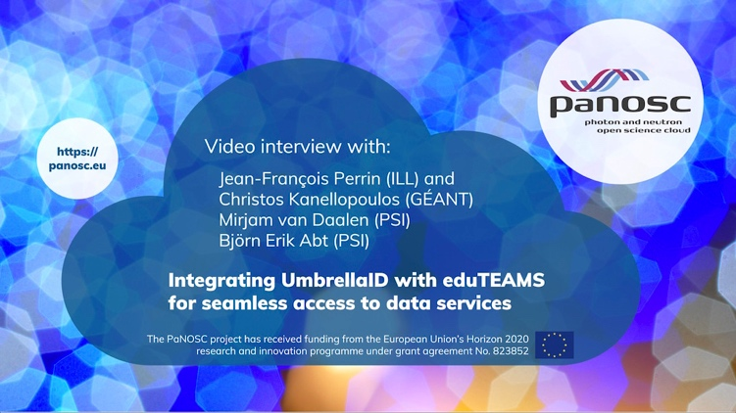

Dissemination activities on PaNOSC achievements
Production of videos on PaNOSC achievements
Interview on the work carried out in the frame of PaNOSC WP6 – EOSC integration, towards the set-up of a federated authorization and authentication infrastructure (AAI) for the users of photon and neutron sources, which will allow a seamless access to data and data services.
Interview with prof. Hans Fangohr (leader of PaNOSC WP4) on OSCOVIDA, the Open Science COVID Analysis website (http://oscovida.github.io) that collects and shows analysis plots of COVID19 cases and deaths to better understand the time development of the pandemic and the measures taken in all countries worldwide.
Full interview: http://bit.ly/36ghSwJ
Full interview: https://bit.ly/2Xm07Lj
Articles and interviews were published on the PaNOSC website and distributed to the PaNOSC network, via direct email and social media

Slide 6

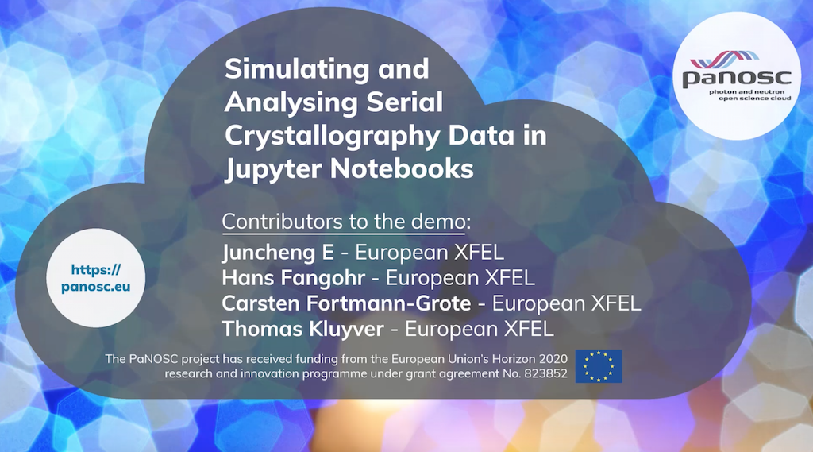
Dissemination activities on PaNOSC achievements
Promotion of demos showcasing the features of the services developed in other WPs
Demo showcasing how PaNOSC aims to implement FAIR principles and how this could help improve the status of data analysis at photon and neutron facilities (PaNOSC WP 4).
Demonstration of simulating and analysing serial crystallography data to show use case for Jupyter Notebooks in the PaNOSC project (PaNOSC WP5)
Watch the video: https://youtu.be/pudgE68jDEY
Watch the video: https://youtu.be/g5_DdVzWiQs

Slide 7
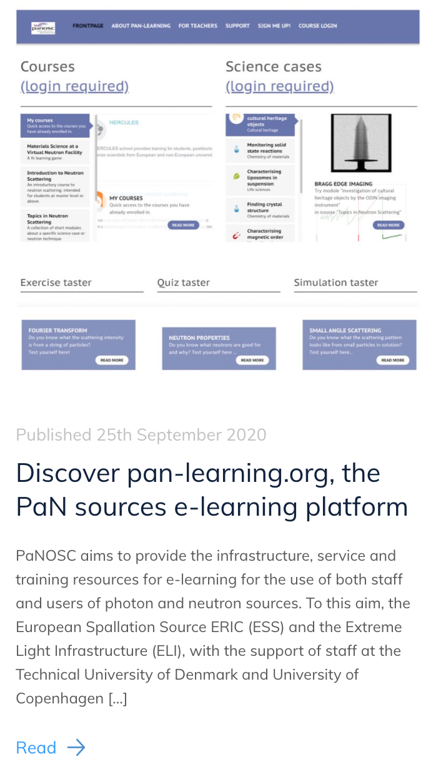
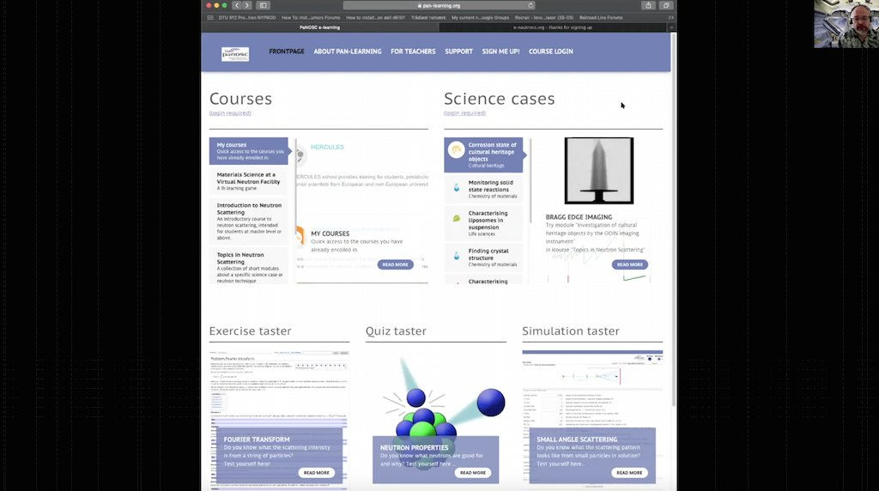
Promotion of pan-learning.org
Demo on pan-learning.org showing its features, and the types of modules and material available on scientific topics related to PaN science.
Watch the video: https://youtu.be/pudgE68jDEY

Slide 8
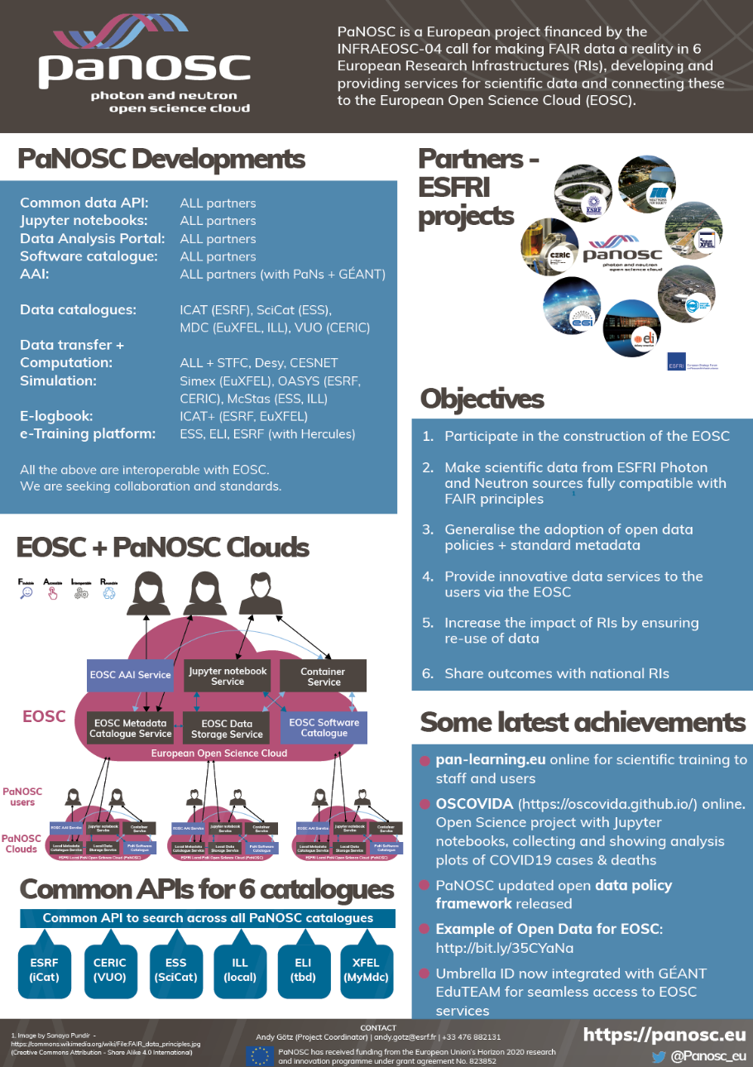
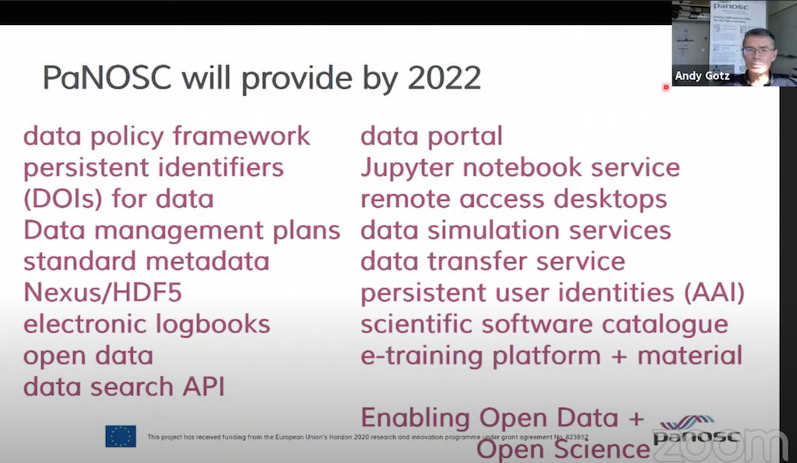
PaNOSC @PaN User Meetings
DESY & European XFEL User Meeting (Jan 2020)
ESRF User Meeting (February 2020)
Talk at ESS/ILL User Meeting (Sept 2020)
Poster Session
@SOLARIS User Meeting
(Sept 2020)
Watch the video: https://youtu.be/i5SLI1rWmqA?t=7626

Slide 9








Participation in collaboration activities with FAIRsFAIR, EOSC Secretariat and the EOSC clusters
Collaboration with other EOSC projects and clusters
Mapping key people in EOSC cluster projects in all domains (management, data policy and stewardship, data analysis / simulation, sustainability, training, communications, etc.) to enhance networking & collaboration: http://bit.ly/EOSCclusters-keypeople

Slide 10


Video Release
Partners / Projects / Initiatives involved:
Watch the video: https://bit.ly/The-DOI-for-Data
LINKED ACTIVITIES:
New mailing lists for queries on DOIs: pan-data-doi@panosc.eu
Action advocating scientific journals to include data DOIs in their published articles

Slide 11
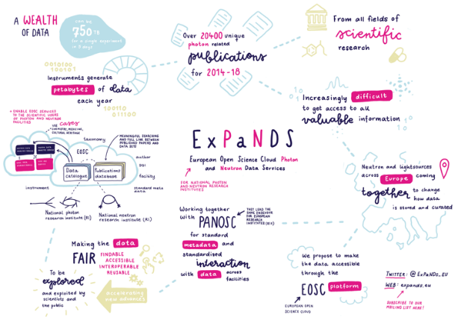
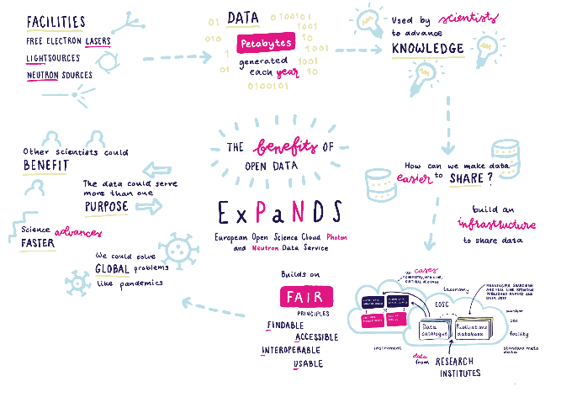
ExPaNDS – WP6 so far
Activities so far and ongoing:
Development of LinkedIn Profile
Creation of three ExPaNDS Videos + Infographics
Continued development of our ExPaNDS website
Regular meetings with WP Leaders in rotation
Regular Site Stakeholder Meetings (UKRI & Diamond)
Meeting held with EOSCLife to gain understanding of project synergies
Taking part in other WP conference calls to understand upcoming activities
Regular Social Media Updates
Review of speaking opportunities as Lund and IUCR have been postponed due to COVID-19
Poster presentation SOLARIS user meeting 9th to 11th September 2020
Organisation and promotion of WP2 FAIR Events 1st & 2nd October 2020
Administration and promotion of ExPaNDS/PaNOSC and CALIPSOplus Technical Coordination Workshop : The Portal Architecture test on 8th & 9th October 2020
Contribution to the planning of the joint annual meeting 9th to 11th Nov 2020

Slide 12

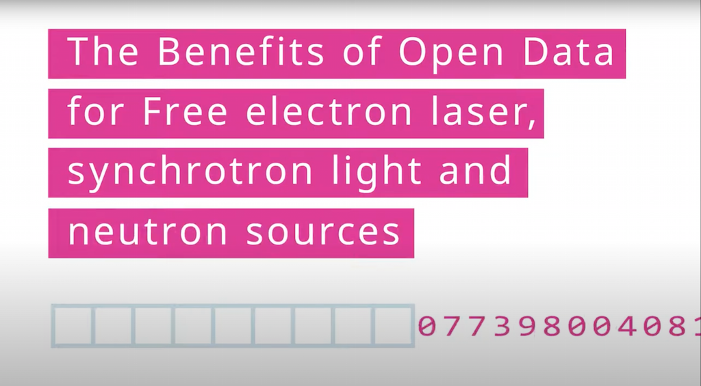
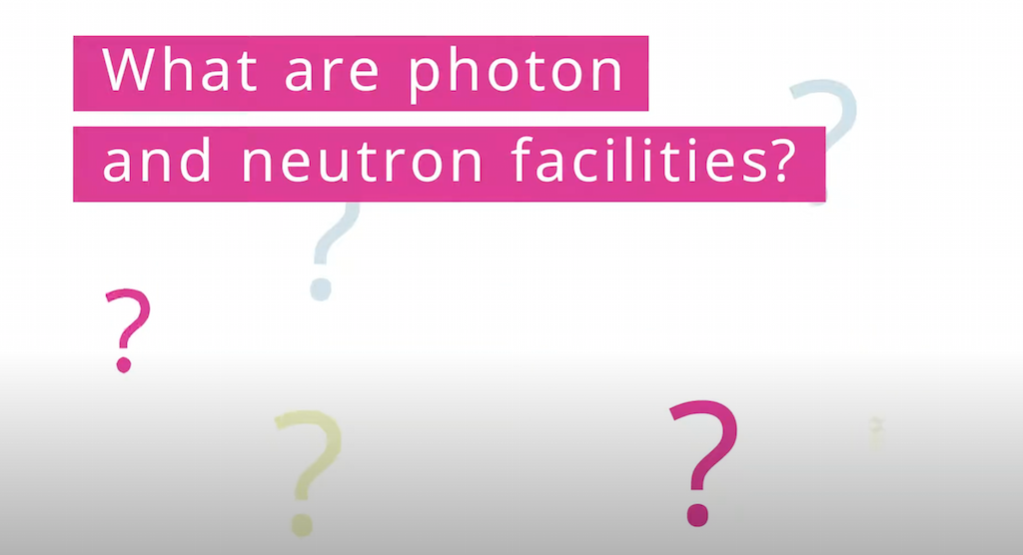
Video Releases - ExPaNDS
Watch the video: https://www.youtube.com/watch?v=f3HUzTabqus
Watch the video: https://www.youtube.com/watch?v=MflGW9Kk0YI
Watch the video: https://youtu.be/Tuct8u47pHI

Slide 13
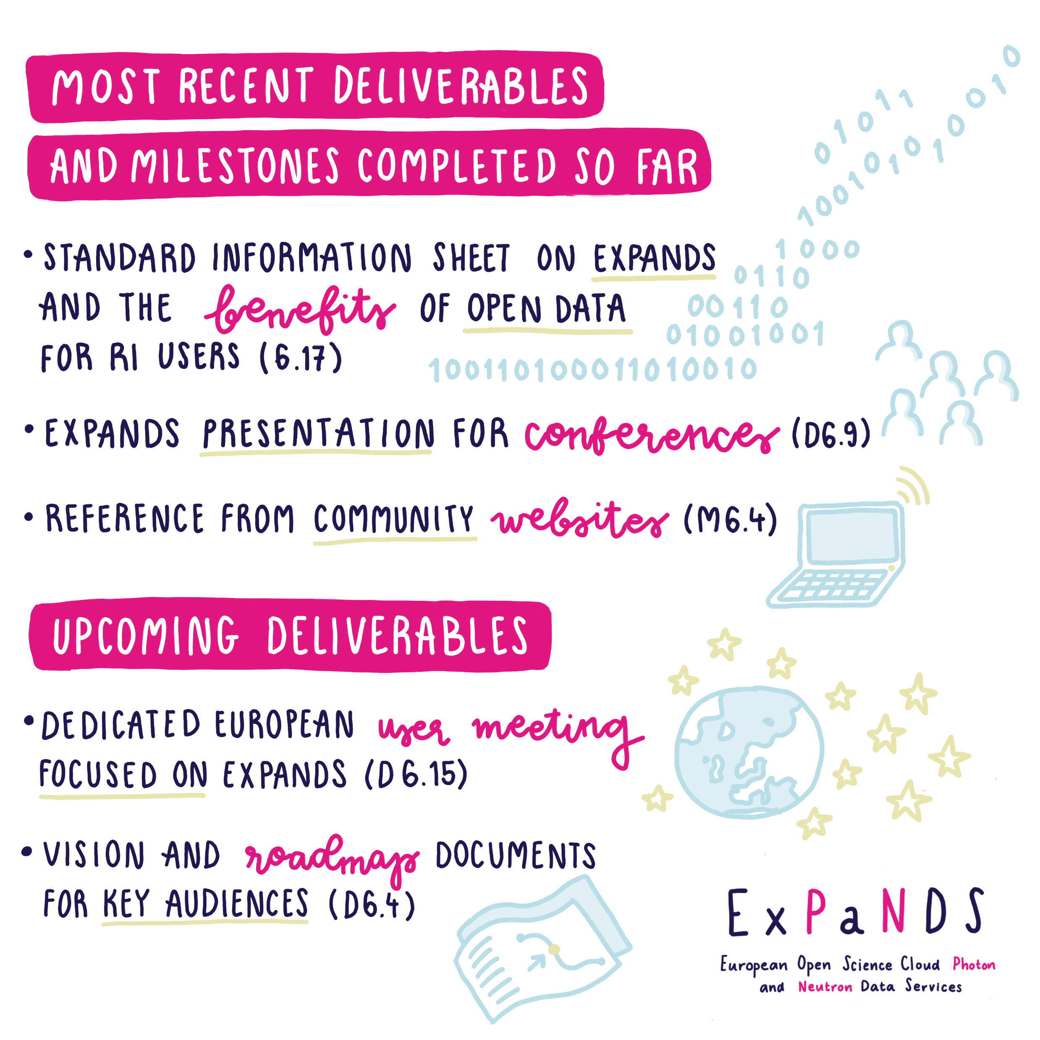
ExPaNDS – WP6 continued

Slide 14
ExPaNDS – WP6 coming up

Slide 15
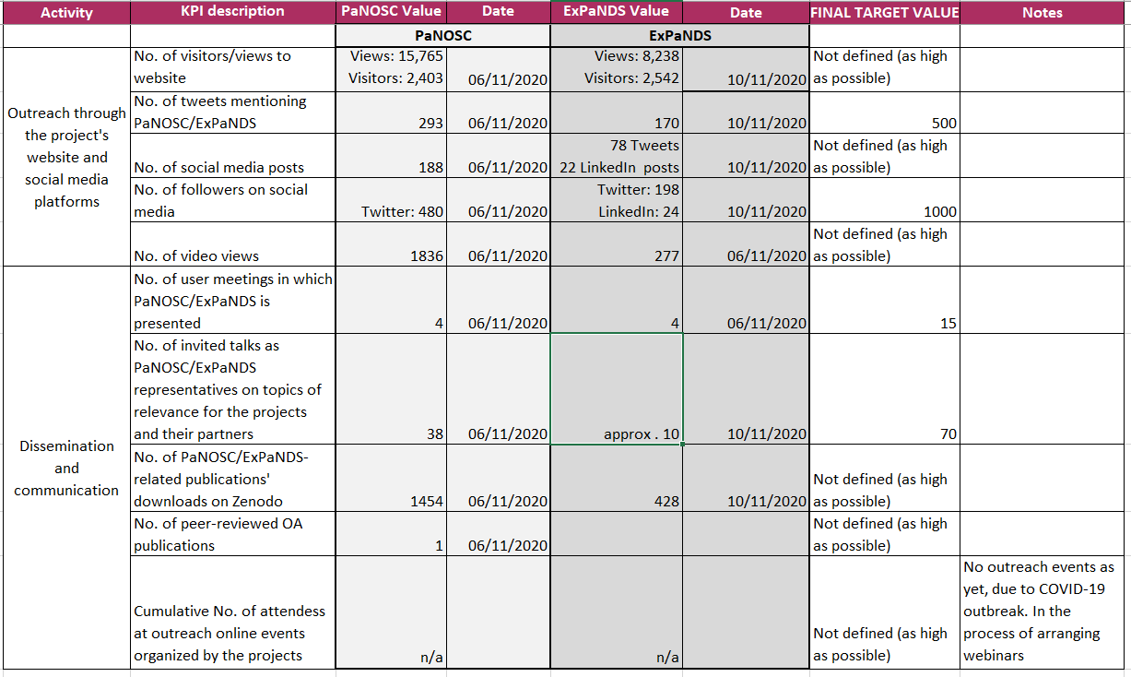
PaNOSC WP9 / ExPaNDS WP6 KPIs

Slide 16
2021-2022 Joint Roadmap
Cross-grant regular communication
External communication
Produce and distribute promotional material of our main projects achievements;
Support our work packages by promoting their activities
Mutually support communications via our social media channels
Mutually support the promoting of our initiatives, events and training material as well as training activities
Enhance interactive participation of the audience attending our events via the tools available within online conferencing tools, and monitor performance
Notes:
Engage with comms staff from all PaNOSC and ExPaNDS partners with periodical meetings to encourage cross-collaboration;
Converge on common KPIs for the projects’ communications/dissemination WPs;
Organize periodical meetings between PaNOSC and ExPaNDS WP9/WP6 leaders.

Slide 17
2021-2022 Joint Roadmap
User Engagement
Target user meetings more widely and jointly
Identify and attend other events and conferences targeting users
Engage with user offices across PaN facilities
Identify and collect user success stories at PaN facilities and publish these use cases
Organise user-centric workshops / meetings (training WPs) and attract participants from the PaN community
Promote and distribute demos / videos on the services developed
Present progress and achievements at our partners scientific board meetings
Promote services and policies via PaN networks (lightsources.org, neutronsources.org, etc.)
Notes:
Ask audience:
upcoming user meetings you are aware
Take part in conference and events targeting the PaN user community (e.g. International Conference on Neutron Scattering, International Conference on Synchrotron Radiation Instrumentation, etc.)
of ?

Slide 18
2021-2022 Joint Roadmap
Collaboration with other EOSC-related projects:
Ensure all cluster projects attend our Annual Meeting and that we attend theirs
Invite 5b / cluster projects representatives to all our workshops / events
Active participation in the EOSC Secretariat's interest group "EOSC Cluster Collaboration" meetings, and related joint actions
Periodical meetings among coordinators of the cluster projects and transfer of the relevant inputs to the leaders of WP comms/dissemination in the various projects, to ensure appropriate communications/dissemination of the set actions and results achieved

Slide 19

Thank you
isabelle.boscaro-clarke@diamond.ac.uk
nicoletta.carboni@ceric-eric.eu
k.roarty@diamond.ac.uk
Follow us on Twitter
@Panosc_eu
@ExPaNDs_EU

